Slide 1
Server Distribution

Slide 2
High Level Network Design

Slide 3
Existing Network

Slide 4
Disaster Recovery

Slide 5
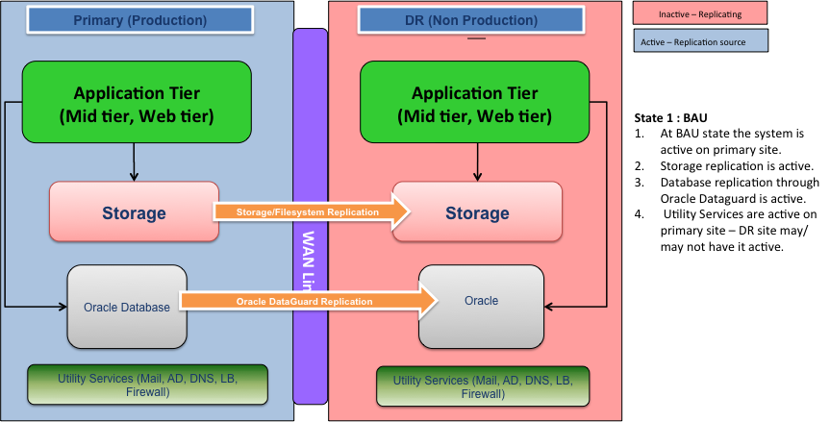
DR – BAU State

Slide 6
Would this work?

Slide 7
Low level - protocols

